Slide 1
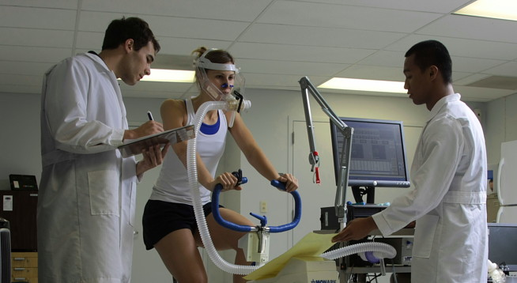
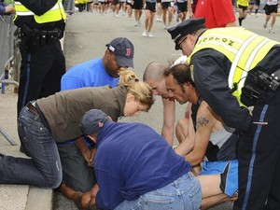
EXERCISE TESTING
(FUNCTIONAL STATUS)
(OUTCOME MEASURES)

Slide 2
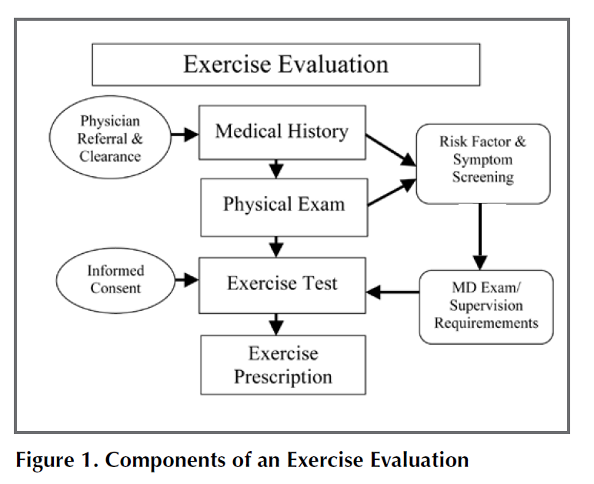
OVER VIEW
Gappmaier E. Cardiopulm Phys Ther J. 23;2012:19-29.

Slide 3
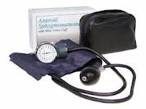
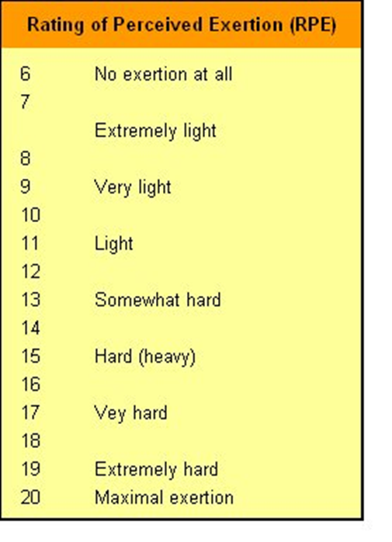
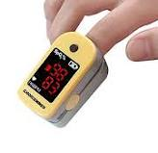
PHYSIOLOGY MONITORING DURING TESTING

Slide 4
PHYSIOLOGY MONITORING DURING TESTING
Heart Rate
  Before, during and after exercise
Blood Pressure
  Before, during (???) and after exercise
Subject self Report of Exertion
  RPE (Rating of Perceived Exertion)
  Before, during and after exercise
Dyspnea
  Before, during and after exercise
ACSM GUIDELINES, 8th edition

Slide 5
PHYSIOLOGY MONITORING DURING TESTING
O2 saturation status: Pulse oximeter
  Before, during and after
Pain levels/Change in Pain Levels
  Before, during and after
Presence of Anginal Pain
  Each stage
ACSM GUIDELINES, 8th edition

Slide 6
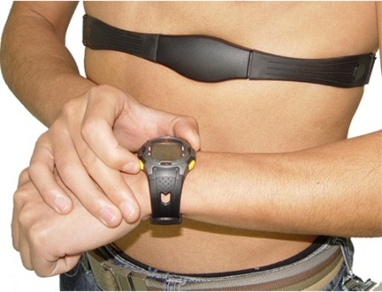
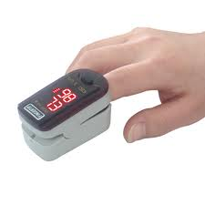
MONITORING HEART RATE

Slide 7
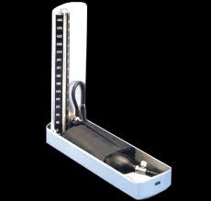
MONITORING BLOOD PRESSURE
Pickering TG et al. Recommendations for blood pressure measurement … Circulation. 2005 111:697.
www.dableducational.org.
  European Society of Hypertension

Slide 8
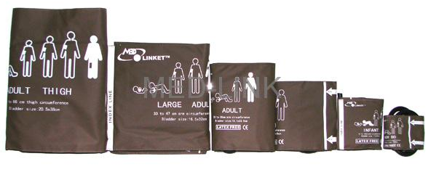
MONITORING BLOOD PRESSURE
  The “ideal” cuff should have a bladder length that is 80% and a width that is at least 40% of arm circumference (a length-to-width ratio of 2:1).

Slide 9
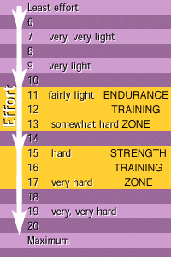
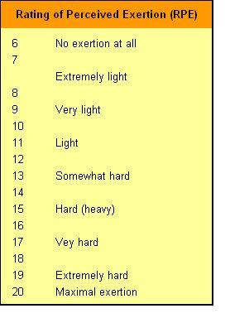
MONITORING EXERCISE INTENSITY
Borg, GA. Med Sci Sports Exer. 1982;14:377

Slide 10
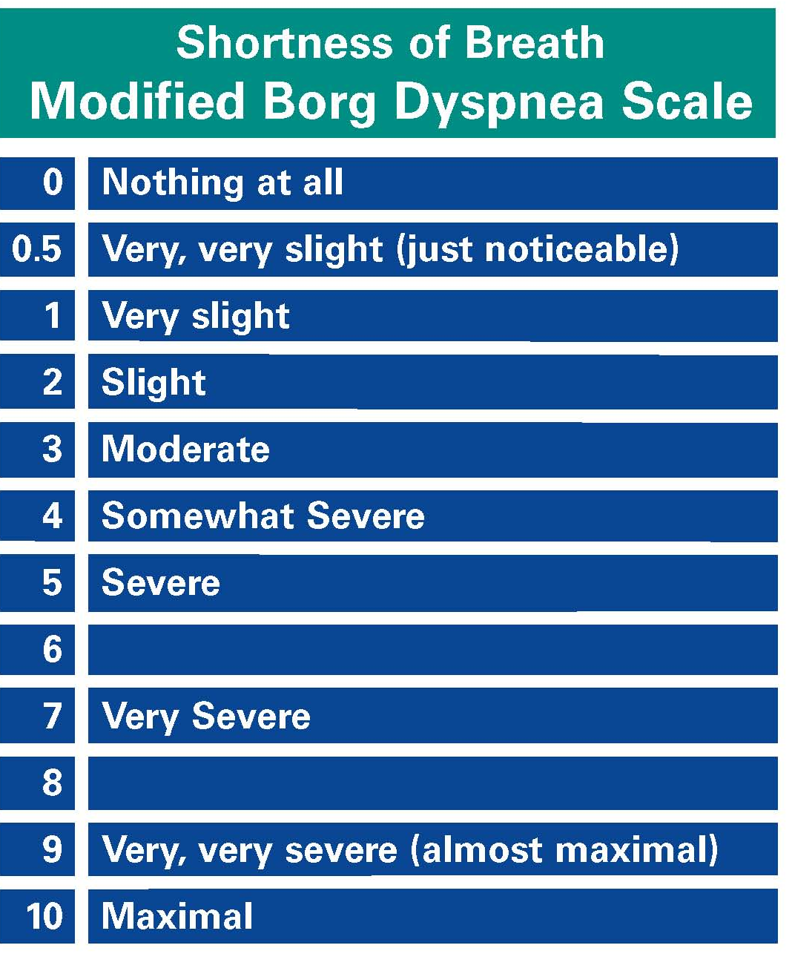
MONITORING DYSPNEA

Slide 11
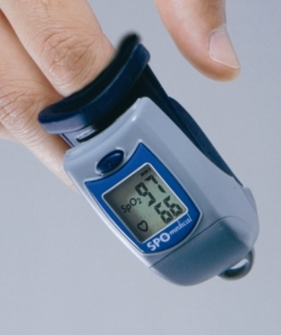
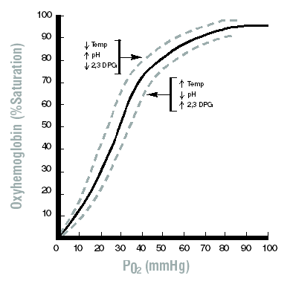
MONITORING O₂ STATUS
Pulse Oximeter

Slide 12
MONITORING PAIN
Patient self report using 0 -10 scale.
Define location
“Did yesterday’s exercise cause any pain this morning?”

Slide 13
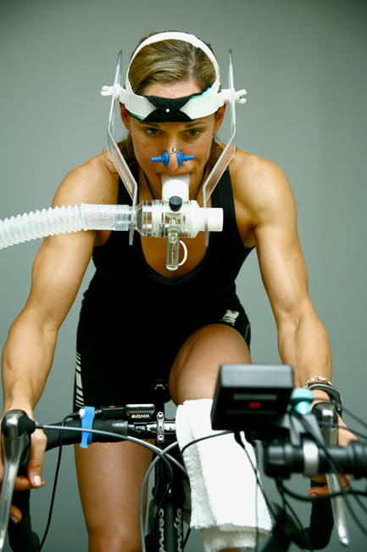
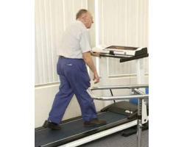
Submaximal Exercise Testing

Slide 14
SUBMAXIMAL EXERCISE TESTING
Noonan V, Dean E. Submaximal exercise testing: clinical application and interpretation.
Phys Ther. 2000;80:782– 807.
Gappmaier E. The Submaximal Clinical Exercise Tolerance Test (SXTT) to Establish Safe Exercise Prescription Parameters for Patients with Chronic Disease and Disability.
Cardiopulm Phys Ther J. 2012. 23(2):19.

Slide 15
SUBMAXIMAL EXERCISE TESTING
Test stopped before maximum exercise capacity has been reached:
  Symptom limited (MS, chest pain, claudication pain, ect.)
  % of max HRpred
Submaximal exercise testing can be done more safely!!
Results can be used to estimate VO_{2 max}

Slide 16
ESTIMATING MAXIMAL HR
Estimating Maximal Heart rate (HRmax):
  HRmax = 220 – age
  Urban myth
  HRmax = 207 - (0.7 X age)
  Gellish et al. 2007
  HRmax = (205.8 – (0.685 X (age))
  Inbar et al. 1994

Slide 17
EXERCISE TESTING PROTOCOL:
Modified Bruce Protocol (Treadmill))
STAGE | ELAPSED TIME (MIN) | SPEED (MPH) | INCLINE (%)
1 | 3 | 1.7 | 0
2 | 6 | 1.7 | 5
3 | 9 | 1.7 | 10
4 | 12 | 2.5 | 12
5 | 15 | 3.4 | 14
6 | 18 | 3.4 | 14

Slide 18
EXERCISE TESTING PROTCOL:
Modified Bruce Protocol (Treadmill))
Heart rate is measured at each stage
RPE is measured at each stage
BP if possible
Criteria for ending/stopping the test:
  Subject achieves estimated HR_{max} ?
  Subject achieves a predetermine % of estimated HR_{max}
  Test is stopped with the appearance of symptoms

Slide 19
Using results from the modified Bruce protocol as an outcome measure/assessment of fitness or function

Slide 20
EXERCISE TESTING PROTOCOL:
Modified Bruce Protocol )
What information can we derive from this test?
  Stage completed
  Exercise Duration (min & sec)
  RPE/Dyspnea at a fixed work load i.e. at a given stage
  Estimate VO_{2peak} by extrapolation or the use of a correlation derived prediction equation

Slide 21
EXERCISE TESTING PROTOCOL:
Modified Bruce Protocol
  Estimating peak VO₂:
    Women active or sedentary: VO_{2peak} (ml/kg/min) = 4.38 X Time (min & fraction) – 3.90
    Men active or sedentary: VO_{2peak} (ml/kg/min) = 14.76 – (1.379 X (time)) + (0.451 X (time²)) – (0.012 (time³)).

Slide 22
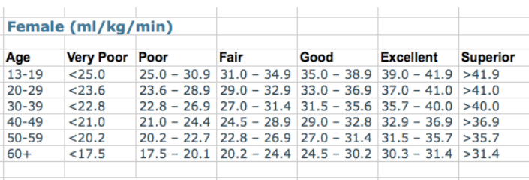
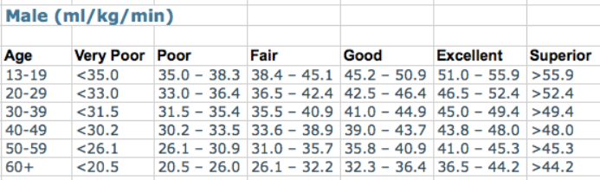

Slide 23
EXERCISE TESTING:
Modified Bruce Protocol
  How can we use the results of this test as an outcome measure?
  Demonstrate need for continued PT service
  Demonstrate achievement of treatment goals
  Demonstrate patient progress

Slide 24
EXERCISE TESTING:
Rocky Mountain Cancer Rehabilitation Protocol
Stage Speed Grade Time
0 1.0 mph 0% 1 min
1 1.5 mph 0% 1 min
2 2.0 mph 0% 1 min
3 2.5 mph 0% 1 min
4 2.5 mph 2% 1 min
5 3.0 mph 2% 1 min
6 3.3 mph 3% 1 min
7 3.4 mph 4% 1 min
8 3.5 mph 5% 1 min
9 3.6 mph 6% 1 min
10 3.7 mph 7% 1 min
Stage Speed Grade Time
11 3.8 mph 8% 1 min
12 3.9 mph 9% 1 min
13 4.0 mph 10% 1 min
14 4.1 mph 11% 1 min
15 4.2 mph 12% 1 min
16 4.3 mph 13% 1 min
17 4.4 mph 14% 1 min
18 4.5 mph 15% 1 min
19 4.6 mph 16% 1 min
20 4.7 mph 17% 1 min

Slide 25
EXERCISE TESTING:
Rocky Mountain Cancer Rehabilitation Protocol
  Test stopped at volitional fatigue
  Time, speed & grade recorded
  If subject is walking at the end of the test:
    VO_{2peak}= (0.1 x S) + (1.8 x S x G) + 3.5
    S= speed; G = grade
  If subject running at the end of the test:
    VO_{2peak} = (0.2 x S) + (0.9 x S x G) + 3.5.

Slide 26
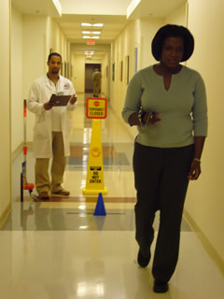
6-MIN WALK TEST

Slide 27
EXERCISE TESTING: 6-MWT
6-minute walk test (6-MWT):
  is a practical simple test that requires a 100-ft hallway but no exercise equipment or advanced training
  measures the distance that a patient can quickly walk on a flat, hard surface in a period of 6 minutes
  is self-paced and assesses patient functional capacity and provides limited information about patient physiologic status
Am J Respir Crit Care Med Vol 166. pp 111–117, 2002

Slide 28
EXERCISE TESTING: 6-MWT PROCEDURE
  Use standardized instructions
  Use a 30 m. course (100-ft hallway)
    Out and back course
  Outcome: Distance walked
  ATS Statement: Guidelines for the Six-Minute Walk Test. Am J Respir Crit Care Med 2002;166;111–117

Slide 29
EXERCISE TESTING: 6-MWT PROCEDURE
6-MWT Procedure:
  Limit your conversation with subject
  A practice test is not needed in most clinical settings but should be considered.
  Only standardized phrases for encouragement should be used during the test.
  Patient may use O₂ and assistive devices during test but if used, use if, possible at retest
  Am J Respir Crit Care Med 2002;166:111–117.

Slide 30
PHYSIOLOGY MONITORING DURING 6-MWT
  Blood Pressure: Pre and post exercise
  Heart rate (HR); Pre, during exercise and post exercise
  Respiratory Rate (RR): Pre and post exercise
  Arterial O2 saturation: Pre, during and post exercise

Slide 31
EXERCISE TESTING: 6-MWT MONITORING
  Rating of perceived exertion (RPE): During and at end of testing
  Rating of breathlessness: During and at end of testing
  Pain/changes in pain

Slide 32
USING RESULTS FROM THE 6-MWT
AS AN OUTCOME MEASURE/ASSESSMENT OF FITNESS OR FUNCTION

Slide 33
EXERCISE TESTING: 6-MWT
NOW WHAT?
Compare to age matched healthy normals:
  Healthy Females
    6-MWD = (2.11 X height_{cm} - (2.29 X weight_{kg} X (5.78 X age) + 667 m
  Healthy Males:
    6-MWD = (7.57 X height _{cm}) – (5.02 X age) – 91.76X wt_{kg} – 309 m

Slide 34
EXERCISE TESTING: 6-MWT
NOW WHAT?
Compare to age matched healthy normals:
  Troosters, et al. Eur Respir J 1999; 14: 270-274
    6-MWD = 218 + ((5.14 x ht._{cm}) – (5.32 X age)) – ((1.80 X wt._{kg})+ (51.31 X gender))
  male =1, female = 0

Slide 35
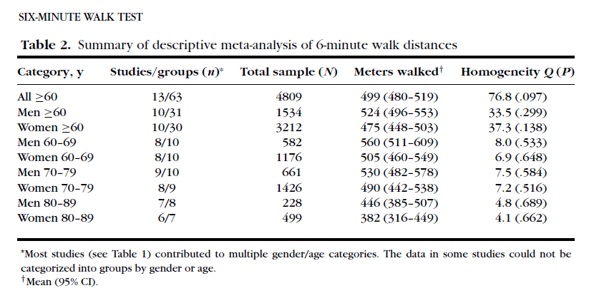
EXERCISE TESTING: 6-MWT
NOW WHAT?
Bohannon R. Topics in Geriatric Rehab. 2007;23:155

Slide 36
EXERCISE TESTING: 6-MWT
NOW WHAT?
Minimal clinically significant difference (MCSD)
  “… the average individual would judge a difference greater than 54 m (37-71 m) as a noticeable difference in functional status.”
  Redelmeier Am J Respir Crit Care Med. 1997:155:1278.

Slide 37
SUBMAXIMAL EXERCISE TESTING
  Single-Stage Submaximal Treadmill Walking Test (SSTWT):
    Warm up: Treadmill, 2.0 – 4.5 mph, 0% grade for 4 min, achieve 50-70% of predicted HRmax
    Increase grade to 5% and then walk for 4 more min.
    Warm down
    Record HR, RPE, at end of each stage, dyspnea, O2 sats

Slide 38
SUBMAXIMAL EXERCISE TESTING
Fixed treadmill speed 5 km/hr
  Patient walked to volitional fatigue
  Possible useful outcomes measures???
  No equations estimating VO2max available
Dimeo et al 1998

Slide 39
SUBMAXIMAL EXERCISE TESTING
Peak Cycling Test:
  1 min unloaded cycling (60 RPM)
  Power is increased by 10 W every minute.
  Test stopped when patient complains of fatigue
  Duration and peak power output recorded
  Monitor HR, RPE, BP, O₂ saturation, and recovery HR
  VO₂ = 7 + (1.8 X work rate (Watts)/body mass)

Slide 40
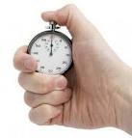
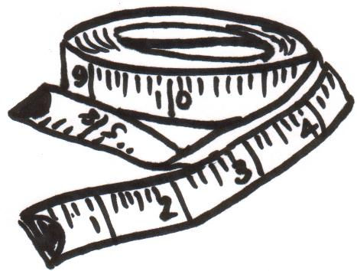
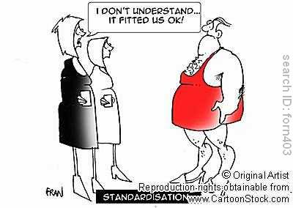
SUMMARY OF AEROBIC TESTING
Standardized techniques

Slide 41
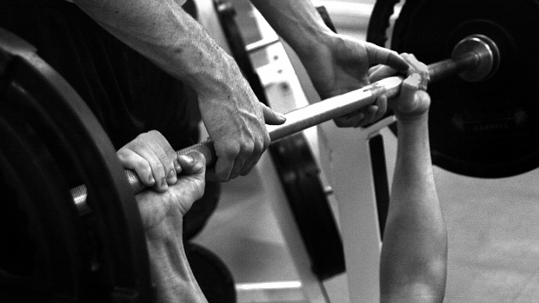
STRENGTH AND STRENGTH ASSESSMENT

Slide 42
IMPROVED STRENGTH: UTILITY
Improved functional capacity
Reduced disability
Increased bone mass
Improved gait speed and gait quality
Improved quality of life
“script” calls for strengthening

Slide 43
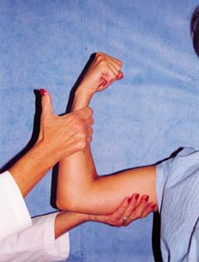
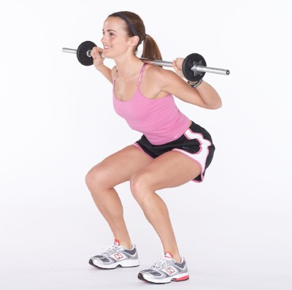
STRENGTH: METHODS OF ASSESSMENTS
0-5 scale (MMT)
1 rep maximum or 1-RM
  The maximum amount of weight that you can lift move with good form

Slide 44
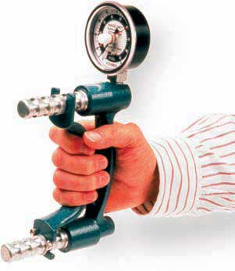
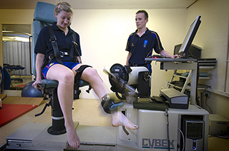
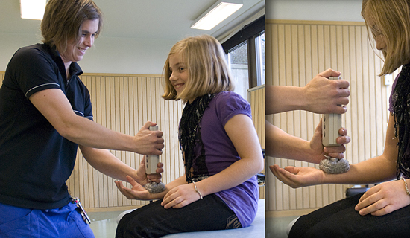
STRENGTH: METHODS OF ASSESSMENTS
Hand held dynamometer
Isokinetic machines

Slide 45
ASSESSMENT: STRENGTH
1-repetition max or 1RM
  The maximum weight a person can lift 1 time through a full ROM with good form
  Warm up
  Select a weight and ask patient to complete a full ROM with that weight
  Complete 1 rep, ask RPE
  Use RPE to assess subject effort
  Shaw et al. J Cardiopul. Rehab. 1995; 15:283

Slide 46
ASSESSMENT: STRENGTH
1-repetition max or 1RM
  Increase weight for next trial by 4-6 lbs.
  30 sec. between trials & alternate UE with LE
  When patient can not move a weight through a complete ROM, test is over
  Previous weight = the 1 RM
  Problems/challenges?
  Shaw et al. J Cardiopul. Rehab. 1995; 15:283

Slide 47
ASSESSMENT: STRENGTH
Predicting 1-repetition max or 1RM
  1 RM = weight that can be moved 10 times resulting in fatigue/0.75
  There is a near linear relationship between the number of reps to fatigue and the percentage of maximum load
  Select a weight, do an exercise to fatigue, count the reps, use the number of reps to define 1-RM

Slide 48
DEFINITIONS: POWER
  Amount of work produced per unit time
  Power = force X velocity
  Reflects a combination of strength and endurance

Slide 49
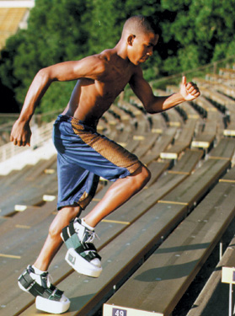
DEFINITIONS: POWER
Power: Work accomplished per unit time
  Peak Cycling Test
  Stair Climb Test
  30 sec. repeated sit to stand

Slide 50
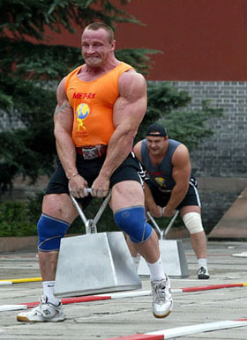
POWER TESTS
Will have a force component and a time component
  Strong man competition
  Gait speed (BW X distance/time)
  TUG, TUDS, 5X/30 sec. repeated sit to stand,
  inclined board

Slide 51
ASSESSMENT: POWER
Stair Climbing Power Test
  Determine the time required to climb 10 stairs as quickly and safely as possible.
  ↑ time suggests ↓ power output
    Reflects reduced muscle function
  Power = (vertical height (m)/time) X (Body Weight) X (9.81 N).
  Power = (1.75 m/time) X (BW) X (9.81)
  Bean JF et al. Arch. Phys. Med. Rehab. 2007;88:604

Slide 52
ASSESSMENT: POWER
Physical Function ICU test
  Marching on spot (MOS)
    Duration, repetitions, cadence (reps/duration)
  Bilateral Shoulder Flexion
    From a standing position raise your hands up and down over your head for as long as you can.
    Duration, repetitions, cadence (reps/duration)
Skinner, E. et al. Critical Care and Resuscitation. 2009;11:110-115.

Slide 53
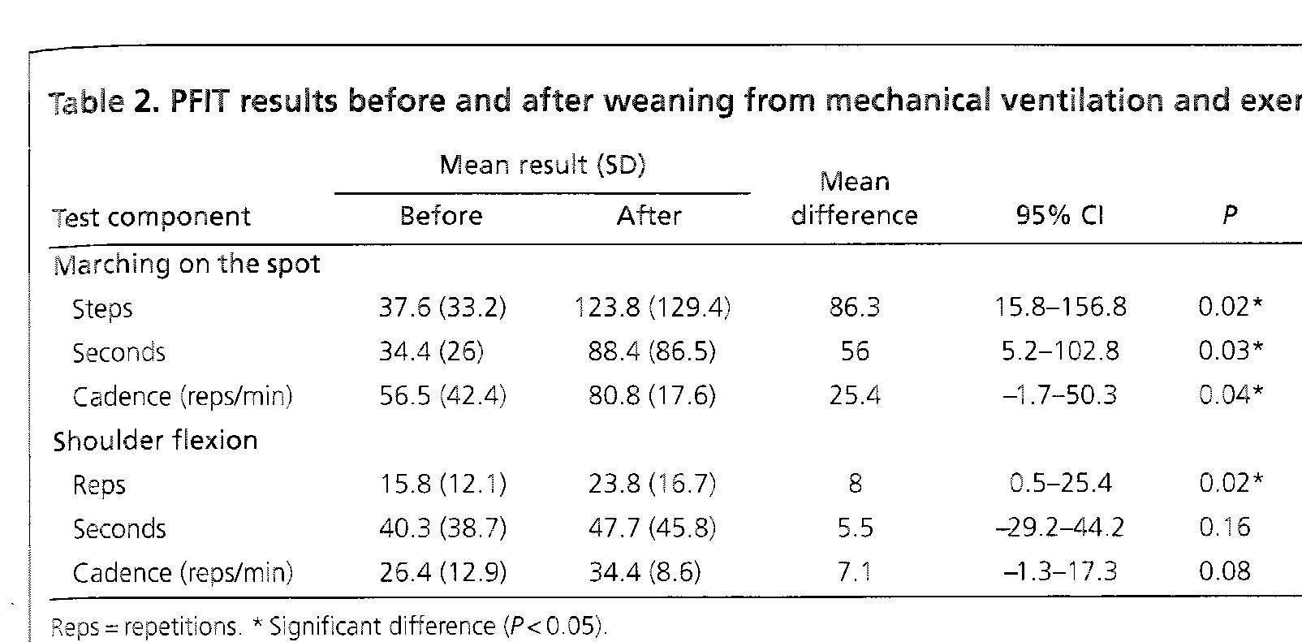
Skinner E et al. Crit Care Resusc. 2009; 11:110.

