Slide 1
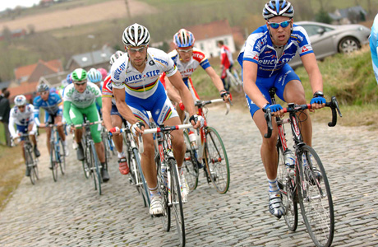
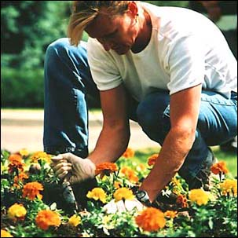
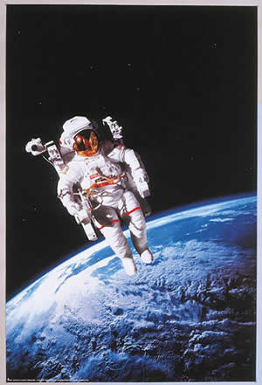
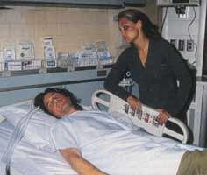
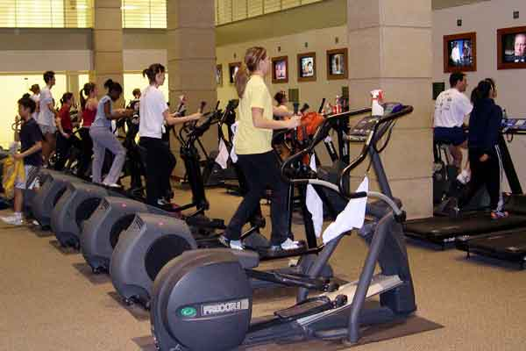
EXERCISE 101

Slide 2
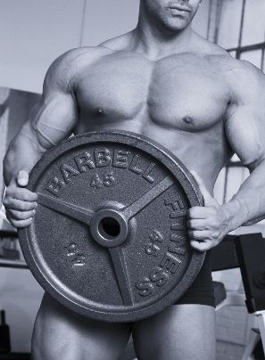
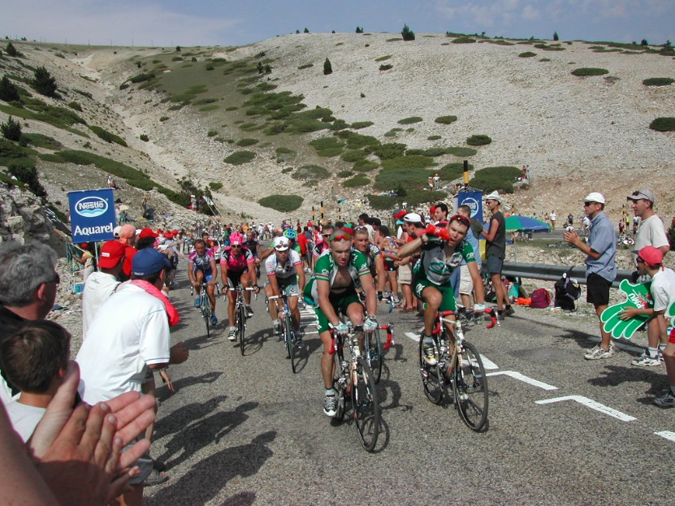
TYPES OF EXERCISE
Aerobic
Resistance/Anaerobic

Slide 3
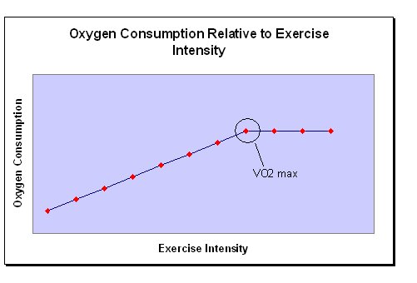
Submaximal VO₂

Slide 4
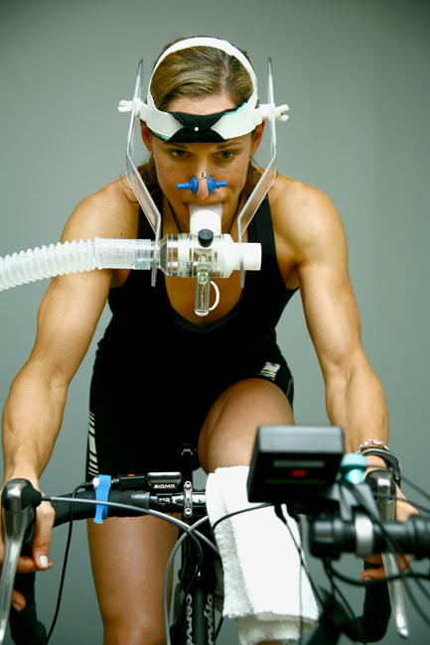
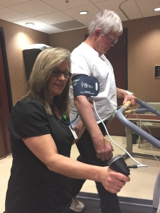
Assessing aerobic capacity VO₂ max

Slide 5
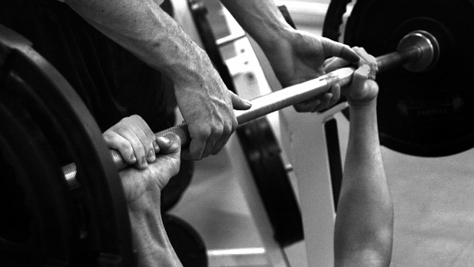
STRENGTH AND STRENGTH ASSESSMENT

Slide 6
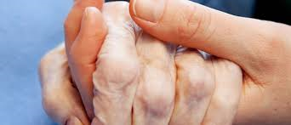
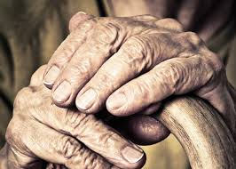
FRAILTY
10% in those over 65
50% in those over 85
Cancer is a disease of aging

Slide 7
Frailty Phenotype/Characteristics
Unintentional weight loss
  > 10 pounds in prior year
  > 5% of body weight in prior year
Weakness
  Grip strength in the lowest 20% at baseline
Poor endurance/fatigue
  Exhaustion/Self report
  How often in the last week did you feel that everything you did was an effort? & you could not get going?
  > 3 days suggest frailty

Slide 8
Frailty Phenotype/Characteristics
Slowness
  Gait Speed (slowest 20% of the population)
  Usual speed for 4 m
  Time > 5 sec; velocity < 0.8 m/sec
Low activity levels:
  Common algorithms to calculate Kcals
    Men < 383 Kcal/wk; females < 270 Kcals/wk
  How demanding is walking, completing chores
  Moderately – strenuous suggests frailty
Fried et al. J Gerontol A Biol Sci Med Sci (2001) 56 (3): M146-M157

Slide 9
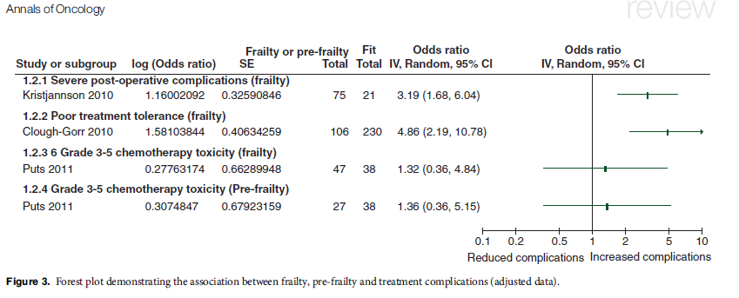
Frailty and Cancer
Over half of older cancer patients have
Frailty or pre-frailty
These patients are at considerably increased risk of mortality, postoperative complications and chemotherapy intolerance.

Slide 10
NO. OF FRAILITY PHENOTYPES | CANCER SURVIVORS (N) | CONTROL POPULATION (N)
TWO COMPONENTS | 301 (31.5) | 13 (7.8%)
> TWO COMPONENTS | 125 (13.1%) | 0 (0.0%)
Adapted from Ness et al. JCO. 2014; 31:4496.

Slide 11
Median age of our 126 CNS tumor survivors was 26 years

Slide 12
Frailty
Develops as a consequence of cumulative decline across multiple physiological systems and increases the risk of adverse outcomes
Fraility: “a state of vulnerability to poor resolution of homeostasis following a stressor event”
Chronological age does not necessarily equal physiologic age
C. Handforth Annals of Oncol. 2015; 26(6):1091-101.

Slide 13
Frailty
Gait speed is considered as the best single-item frailty screening tool
Worth assessing in the cancer survivor
Participation in an exercise programs is useful in managing frailty
Theou et al. J Aging Res. 2011:569194.

Slide 14
FRAIL QUESTIONAIRE
1. F (Fatigue): Is the patient easily fatigued? Y/N
2. R (Resistance): Is the patient unable to walk up one flight of stairs? Y/N
3. A (Ambulation): Is the patient unable to walk one block? Y/N
4. I (Illnesses): Does the patient have more than five illnesses? Y/N
5. L (Loss of weight): Has the patient lost more than 5% of their body weight in the past 6 months? Y/N
SCORING
ROBUST: 0 Y; 1-2 Y PREFRAIL; 3-5 Y FRAIL

Slide 15
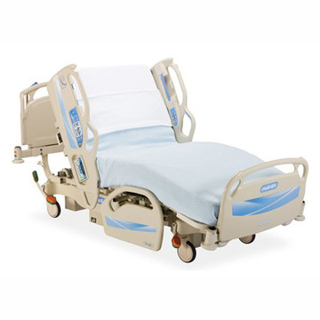
BED REST/DISUSE ATROPY

Slide 16
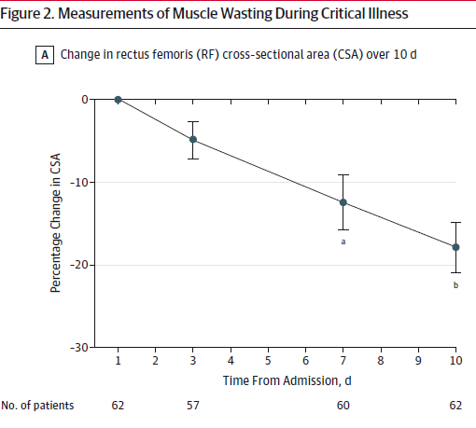
Puthucheary ZA et al. JAMA. 2013;310(15):1591-1600

Slide 17
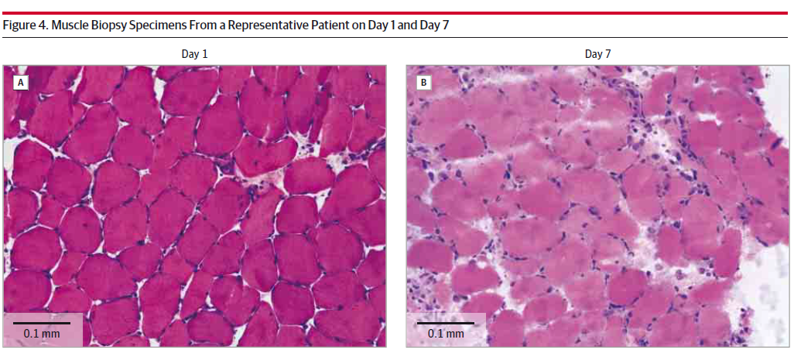
Bed rest/disuse atrophy
Puthucheary ZA et al. JAMA. 2013;310(15):1591-1600

Slide 18
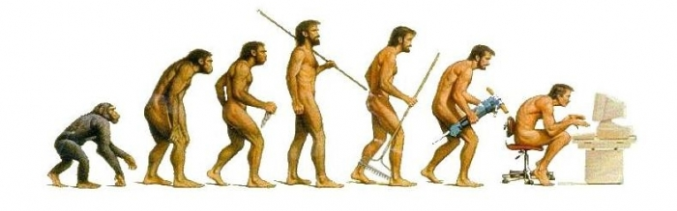
Sitting Behavior
Too much sitting time!!!!!!
Sitting is not equivalent to inactivity
American Cancer Society
  Identifies it as a problem/Calls it “screen time”
  Calls for a reduction in screen time in survivors
Lynch et al. Cancer. 2013:119;1928

Slide 19
Sitting Behavior
Excessive sitting behavior has been associated with deleterious health outcomes including increased cancer risk, increased morbidity and mortality
Increased symptom burden!
Hence, reducing sitting time can, potentially, reduce symptom burden on the patient
Lynch et al. Cancer. 2013:119;1928

Slide 20
Sitting Behavior
Consider:
  Of 157 patients in a primary care clinic
    10% received general advice to decrease sitting time
    53% received general physical activity counselling
    0% received a treatment plan for reducing sitting time
    14% received a written physical activity prescription
    Shuval et al. Br. J Sports Med. 2014;48:1451

Slide 21
Sitting Behavior
Get off the couch and walk around during TV commercial breaks.
Do household chores, such as folding clothes, washing dishes, or ironing, while watching television.
Stand to read the morning newspaper.
Wash your car by hand rather than an automated car wash.
Move around the house when checking text messages and email on your mobile phone.

Slide 22
Sitting Behavior
Stand and take a break from your computer every 30 minutes.
Take breaks in sitting time in long meetings.
Use the stairs.
Stand during phone calls.
Walk to your colleagues' desk instead of phoning or emailing.
Drink more water - going to the water cooler and toilet will break up sitting time.

Slide 23
Sitting Behavior
Move your trash bin away from your desk so you have to get up to put something in it.
Use a height-adjustable desk so you can work standing or sitting.
Have standing or walking meetings.
Use a headset or the speaker phone during teleconferences so you can stand.
Eat your lunch away from your desk.

Slide 24

We have questions!!!!!!

Slide 25
Is Exercise Safe for the Cancer Survivor?
No reports of morbidity or mortality during maximal exercise testing of cancer survivor:
  Scheetz J et al, APTA CSM, Nashville, TN, Feb., 2008
  Jones LW et al, Lung Cancer 2007;55:225
  Schmitz et al. Cancer Epidemiol Biomarkers Prev 2005;14:1672-80

Slide 26
Can the Cancer Survivor Adapt to Exercise Training?
Patients: Stage II Breast cancer patients undergoing treatment
Exercise Protocol:
  10 week aerobic interval-training cycle ergometer program
  Session Duration: 20-30 minutes
  Frequency: Exercised 3 X/week
  Intensity: 60-85% of HR max
    M. Winningham. Unpublished dissertation. OSU 1984
Notes:
Is it worth the effort for the cancer survivor to engage in exercise training?

Slide 27
Can the Cancer Survivor Adapt to Exercise Training?
Outcomes:
  Able to complete training program
  Trained subjects were able to work harder i.e. achieved a higher peak work load
  Trained subjects were able to work longer
  Trained subjects had a 40% increase in peak VO₂
    M. Winningham. Unpublished dissertation. OSU 1984

Slide 28
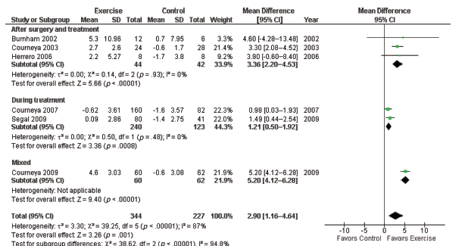
Can the Cancer Survivor Adapt to Exercise Training?
Jones et al. The Oncologist. 2011;16:112
Notes:
Results from a meta analysis of changes in peak VO2 of cancer survivors following exercise training.
6 studies involving 344 participants in an exercising group and 227 in the non exercise group.
Pooled data indicate a significant increase in vo2 peak
Importantly, Usual care (control) was associated with a significant decline in VO2peak from baseline to postintervention

Slide 29
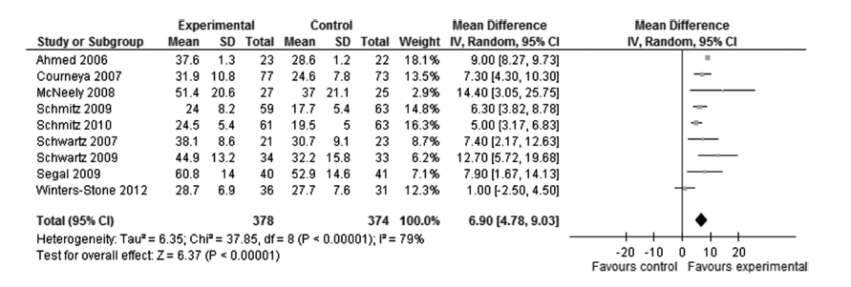
Strasser et al. Med. Sci. Sports Exerc. 2013;45:2080–2090.

Slide 30
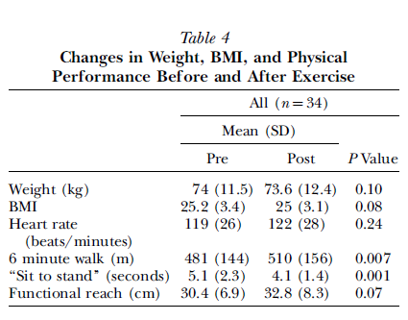
Can the Cancer Survivor Adapt to Exercise Training?
    Oldervoll et al. J Pain Symptom Management. 2006;31:421.

Slide 31
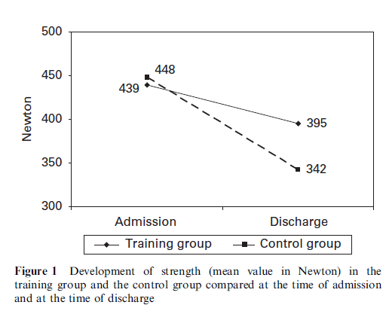
Can the Cancer Survivor Adapt to Exercise Training?
Baumann et al. Bone Marrow Transplant. 2010;45:355.

Slide 32
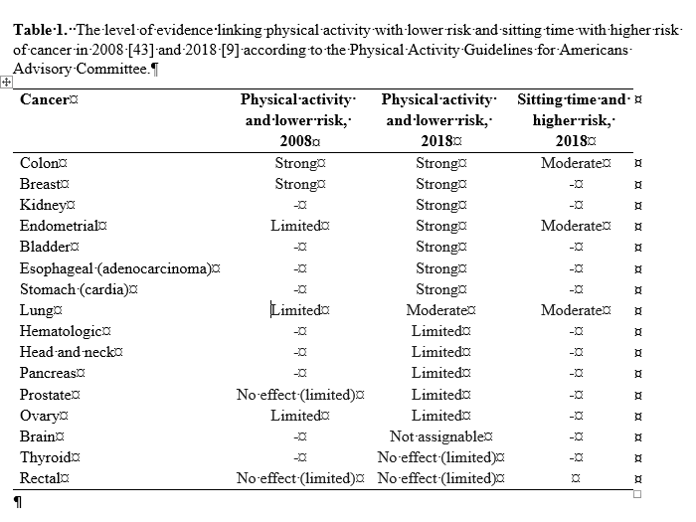
Exercise and Cancer Prevention
Patel AV, et al. In Press Med & Sci in Sport & Exer.

Slide 33
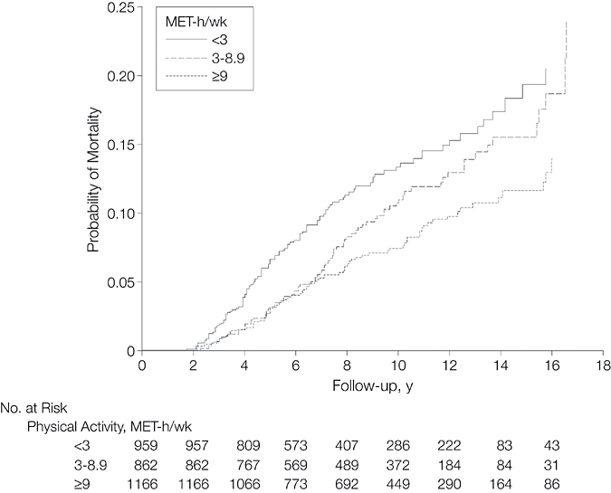
Cancer Recurrence
Holmes, M. D. et al. JAMA 2005;293:2479-2486.

Slide 34
Summary
Cancer survivors tend not to exercise after the diagnosis or after completing treatment.
Cancer survivors can safely participate in exercise training at all points along the cancer trajectory.

Slide 35
Summary
Cancer survivors can adapt to exercise training at all points along the cancer continuum.
Exercise training can bring about positive physiological and psychological changes in cancer survivors

Slide 36
SO WHY ARE WE REALLY HERE TODAY?????

Slide 37
WHY???
IMPROVEMENTS IN
Muscle mass, strength, power
Physical function
Physical activity levels
Range of motion
Immune function
Chemotherapy completion rates
Body image, self esteem and mood
REDUCTIONS IN
Number of symptoms and side effects
Duration of hospitalization
Reduced severity of side-effects reported
Psychological and emotional stress
Depression and anxiety

Slide 38
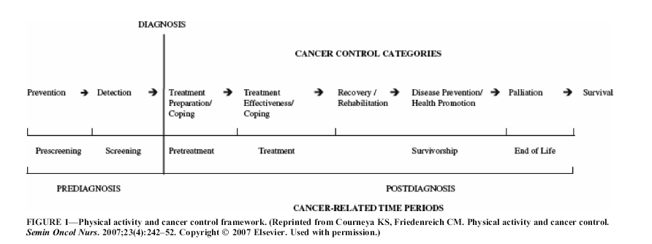
WHY????

Slide 39
Oxygen Consumption and ADL’s
WHY????
Ivey et al. Topics in Stroke Rehabilitation. Wntr 2005 v12 i1 p1(16).

Slide 40
WHY ?????
Counter measure to:
  Adverse effects of bed rest
  Frailty
  Sarcopenia (age related loss of muscle and strength)
  Increased fall risk

Slide 41
WHY ?????
We want to improve our patients’ physical functional capacity.
We want to reduce the impact of impairments on our patients’ ability to be acitive and participate (ICF model)
What has that got to do with increasing VO_{2 max} or 1-RM?

Slide 42
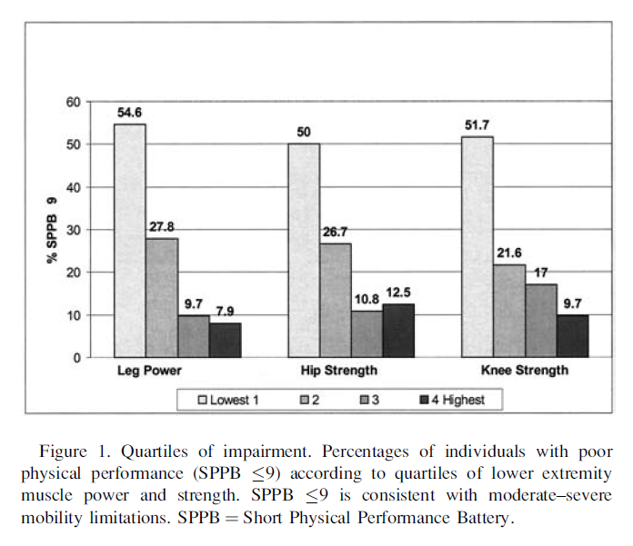
Linking Exercise Capacity to Function!!!!
Bean JF, et al. J of Gerontology: MEDICAL SCIENCES. 2003;58A: 728

Slide 43
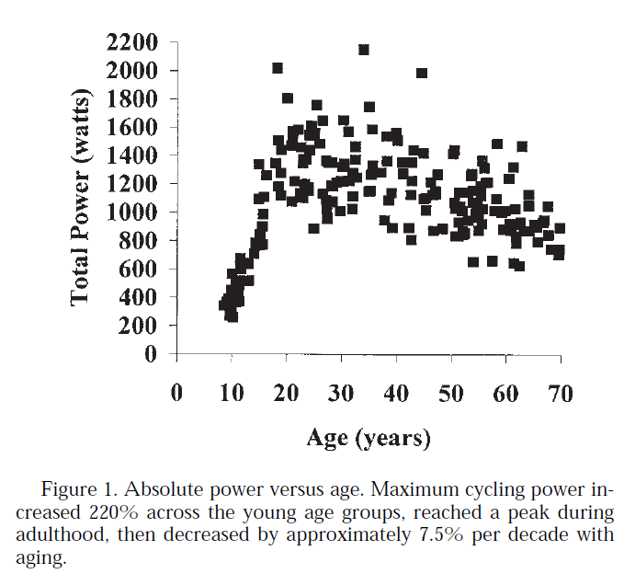
Martin, Farrar, Wagner, Spirduso. Journal of Gerontology: MEDICAL SCIENCES. 2000;55A: M311

Slide 44
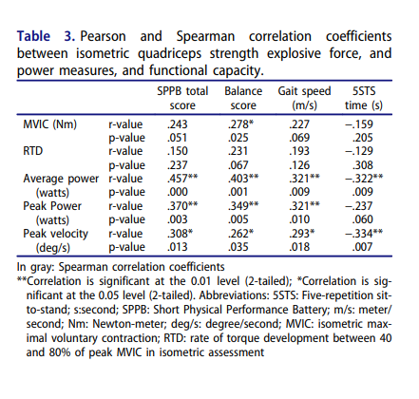
Linking Exercise Capacity to Function!!!!
Kim-Ly Bui, et al. 2019. Physiotherapy Theory and Practice, DOI:
10.1080/09593985.2019.1669233

Slide 45
Linking Exercise Capacity to Function!!!!
Strong Evidence supports the conclusion that “Moderate intensity aerobic training , resistance training or combined aerobic plus resistance training performed three times weekly for 8-12 weeks can significantly improve self-reported physical function”
And is sufficiently strong to recommend a defined exercise prescription

Slide 46
